Slide 1
Computer Science Workshop
Faris Almlih, Eisha Chaudhary, Jake Cowling, Andrei Dan, Fiyin Duro-Ladipo, Prajesh Shukla, Jason Wong

Slide 2
What is the dataset?
The dataset we have chosen details the salaries from various AI related jobs
We chose it due to the relevance it has towards all of us and our chosen career and due to the amount of data included
Column names include work year, experience level, employment type, job title, salary, salary currency, salary in USD, employee residence, remote ratio, company location and company size
Contains over 70000 entries

Slide 3
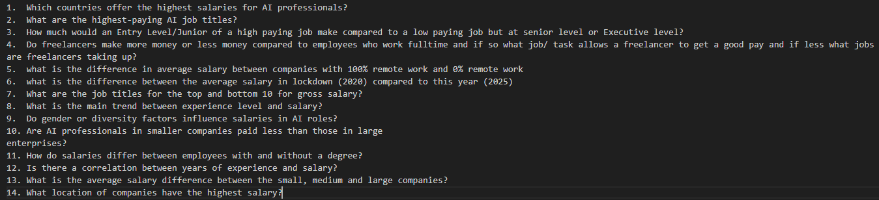
What can be extracted? (questions)
Many different statistics can be extracted from this dataset in relation to job salaries (country, job title etc.) so each person in the group has chosen 2 questions to investigate.
A list of the questions that were chosen is shown below although they will be explained in more detail later in the presentation.

Slide 4
Application Structure
The structure of our application was decided to include:
The ability to take user input
A main menu
Menu options such as view dataset, view column names and view dataset info
A question selection screen
The way the application will function is through a main menu displaying the options listed above and providing the user the ability to input which feature they would like to use

Slide 5
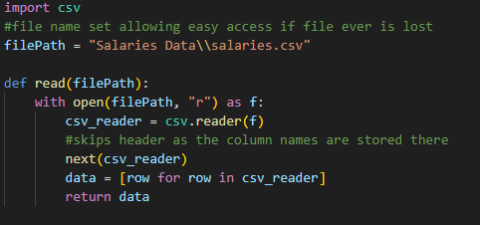

Implementation (file reading function)
The file reading function went through a couple iterations eventually landing on the pandas version shown on the bottom right
1st version: lengthy is code and doesn’t allow the dataset to be viewed well due to how its stored in a list
2nd version: concise code which is easy to understand, allows the viewing of the dataset in a formatted way and allows it to be accessed easily.

Slide 6
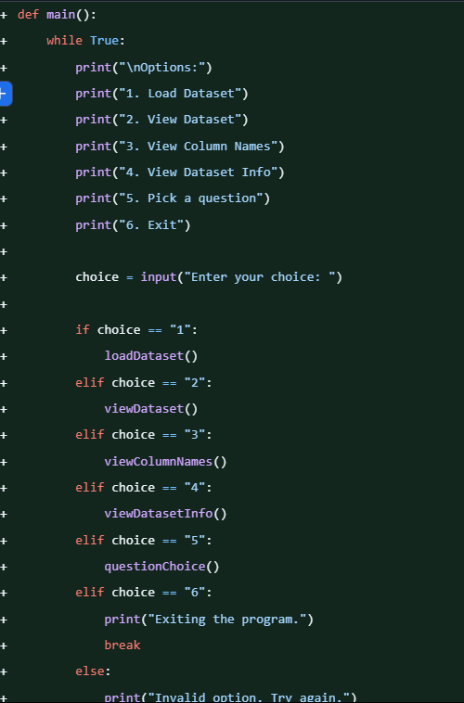
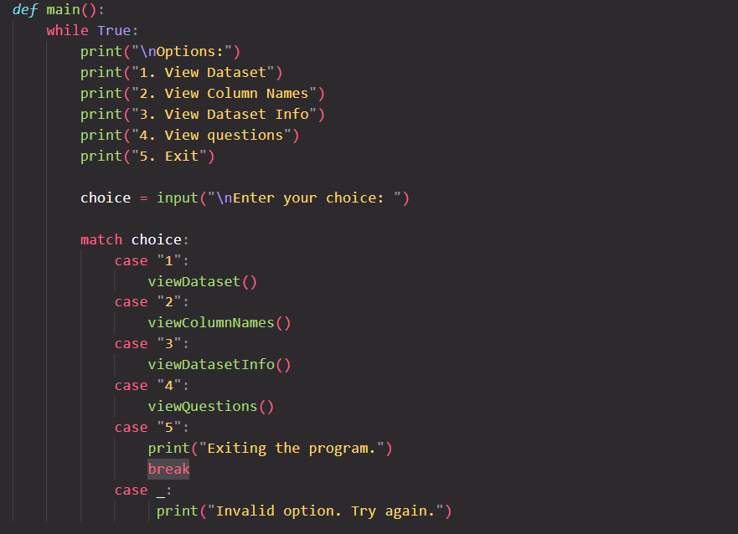
Main Menu (structure)
The structure of the menu was created by brainstorming the related features that are needed to understand the dataset and the information that is to be shown by the questions
Functions identified: load dataset, view dataset, view column names, view dataset info, pick question and quit.
Originally used a series of if and elif statements although was switched to a case structure later.

Slide 7



Main Menu (function)
Applying function to the main menu options:
Load dataset: moved to when code is run
View dataset: simple, mostly taken care of by the file reading function printing out the results
View column names: extracts the first column of data and adds it to a list then prints it out
View dataset info: dataset info is stored in a separate file where it is then read and stored in a variable which is then printed out.

Slide 8
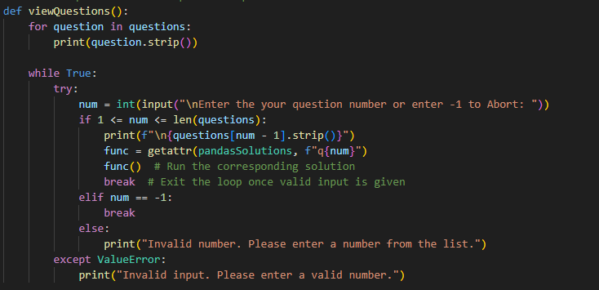
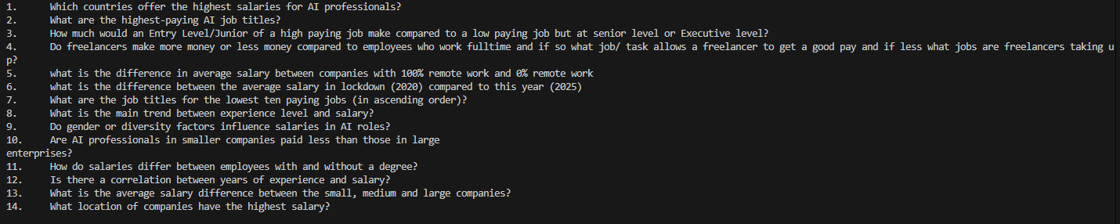
Question Picking Function
Code displays all questions that are stored within a text file and dynamically adds the ability to call the functions of any future questions added
Calls function of question selected by adding the number user enters to the name of a function.
Handles validation through try catch

Slide 9
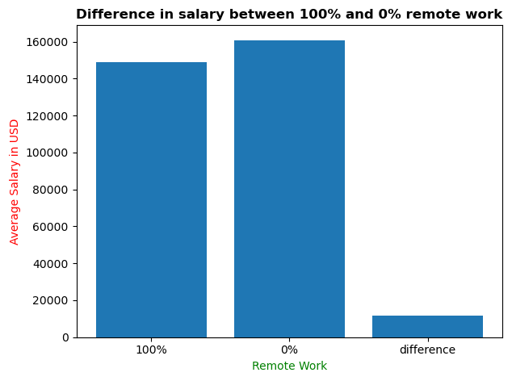
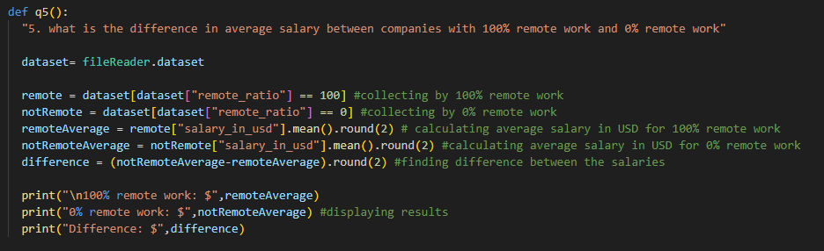
Questions (Jason)
5. what is the difference in average salary between companies with 100% remote work and 0% remote work
The result of the question is that on average jobs with no remote work pay slightly more than jobs that have 100% remote work
The difference is minimal
Visualisation

Slide 10
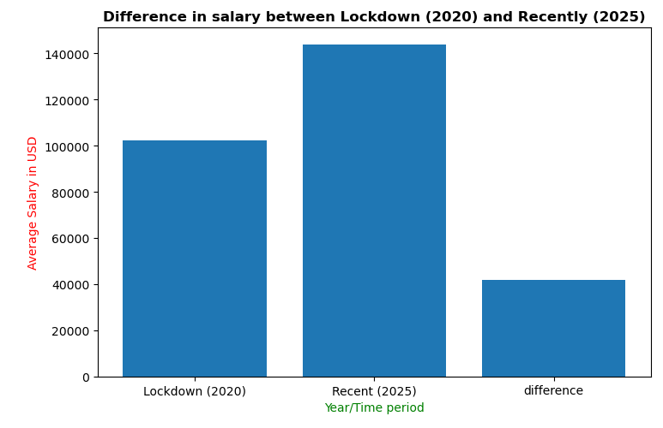
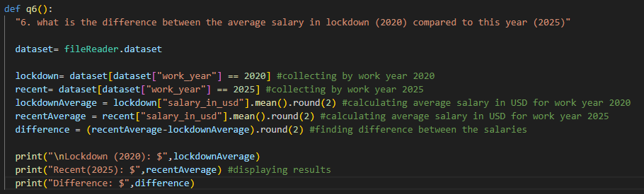
Questions (Jason)
6. what is the difference between the average salary in lockdown (2020) compared to this year (2025)
The result shows that jobs in the current year pay more than jobs in lockdown (2020) although this can be contributed to many factors such as inflation and the inability for people to leave their houses during that year
The difference is significant
Visualisation

Slide 11
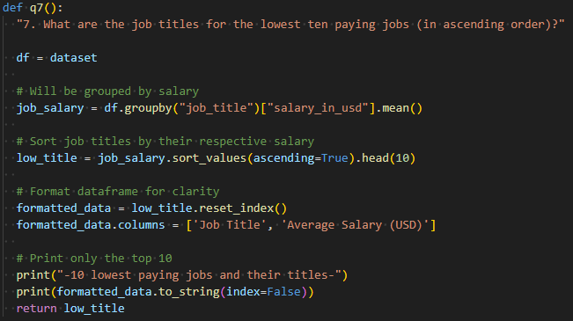
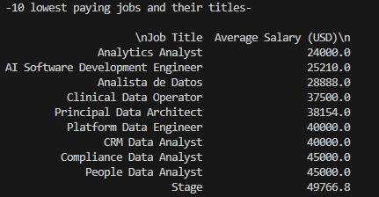
Questions (Jake)
7. What are the job titles for the lowest ten paying jobs (in ascending order)?
As we can see in the results, a range of ~$25,000 between the lowest paying job title and the tenth lowest paying job title but also shows differences in what the job is about.
The lowest paying job is an analytics analyst at $24,000 whereas a people data analyst makes over $20,00 more than that showing the things they are analysing are important to consider.

Slide 12
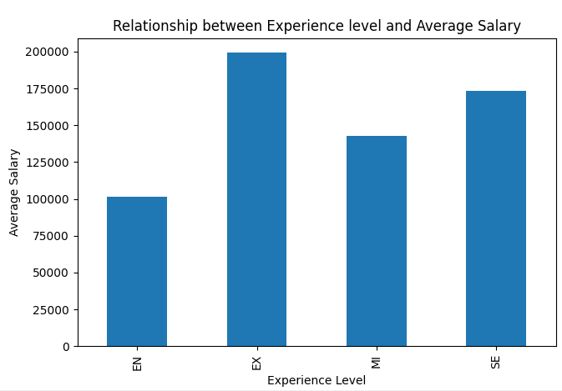
Questions (Jake)
8. What is the main trend between experience level and salary?
As we can see The executive-level holds the highest average closely followed by Senior level. Mid level follows closely behind that but there is a noticeable difference when we get to entry level, however this is to be expected. So, although the order is as expected we can still see to what extent and how closely each are followed with each other.

Slide 13
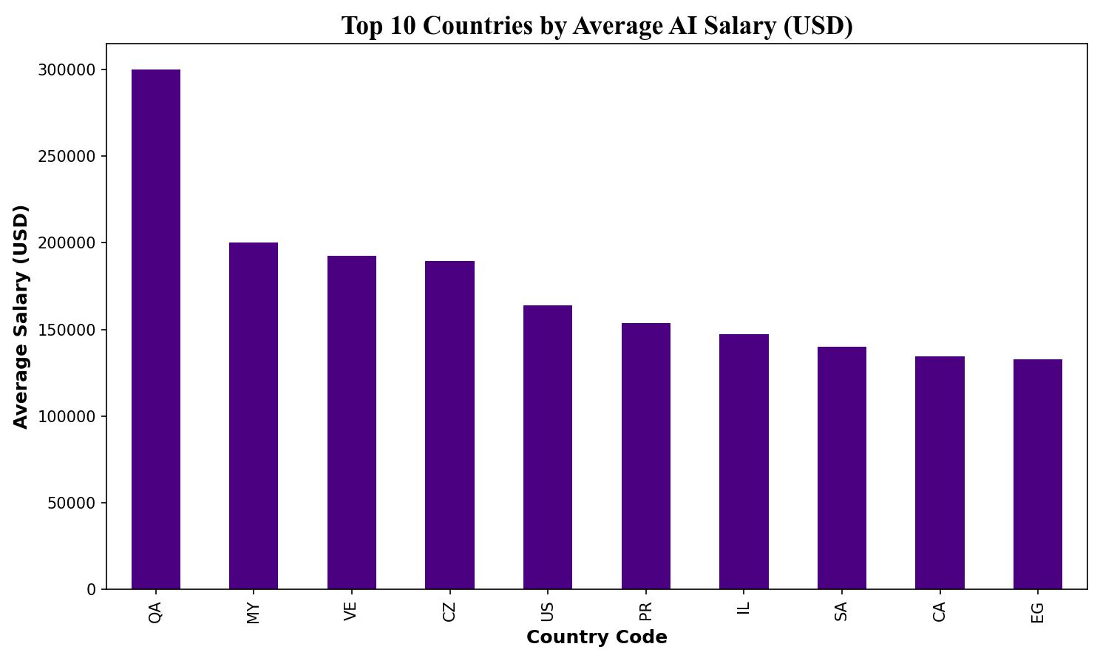
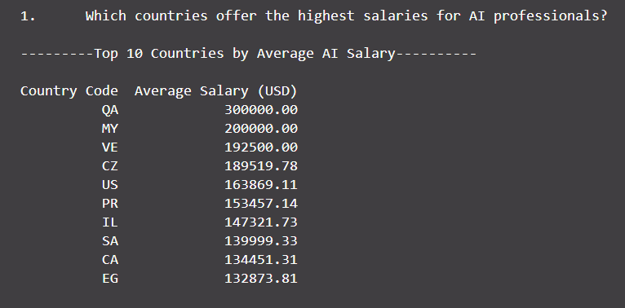
Questions (Fiyin)
Which countries offer the highest salaries for AI professionals?
The top 10 countries with the highest average AI salaries were identified based on employee residence.
Countries like Qatar, Morocco, and Venezuela lead the list. Salaries are highest in regions with strong tech industries and high living costs.

Slide 14
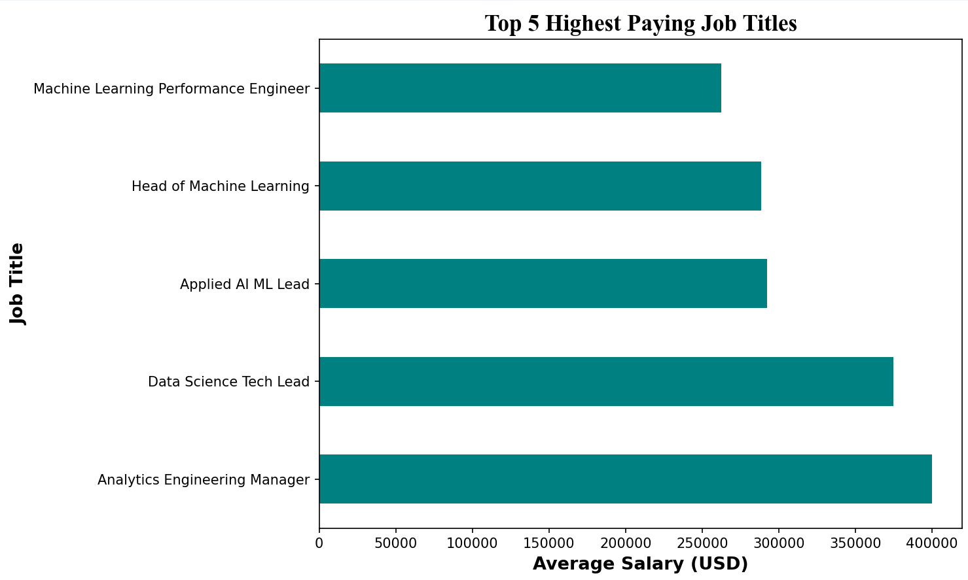
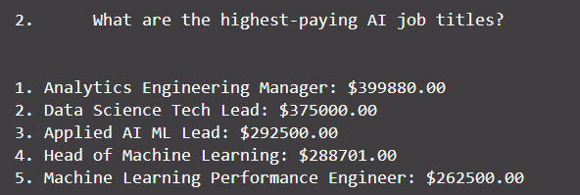
Questions (Fiyin)
What are the highest-paying AI job titles?
The top 8 highest-paying AI roles were identified based on average salary in USD.
With Analytics Engineering Manager, Data Science Tech Lead, and Applied AI/ML Lead coming out as the top 3 most paid roles.
These positions typically require advanced expertise and leadership responsibilities.

Slide 15
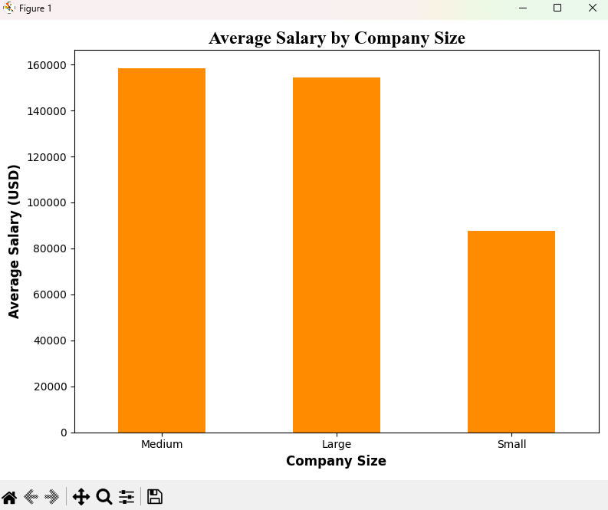
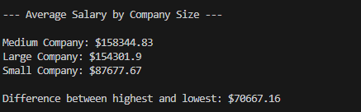
Questions (Andrei)
My first question was what was the average salary difference between the different company sizes.
This showed that the medium company ended up having the largest average salary with the large company just right behind it by $4000 and the small company having the lowest average salary of $88000 rounded.
It also shows the difference between the highest and lowest average salary of the company sizes.
I was expecting for the large company to have the highest salary but maybe medium size company needs employers with better skills to grow their business, so they are getting paid more.
Question 13

Slide 16
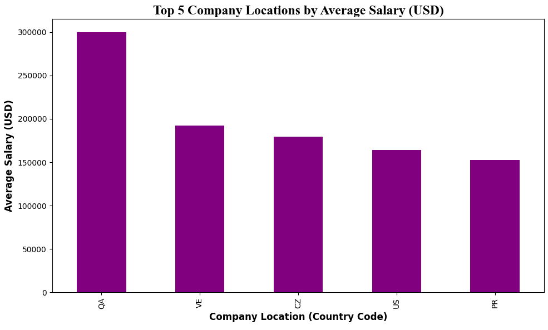
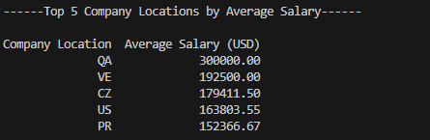
Questions (Andrei)
I was showing the top 5 locations that had the highest average salary.
The data displays that QA had the highest salary by a whopping $300000 which is a really high amount showing that there is professionals that are managing important projects which take a lot of skill and time.
VE second with $192500, CZ being not far behind with $180000 rounded, US on $160000 and PR $150000.
This shows that these countries have a lot of job offerings with high skilled individuals that can take care of big tasks.
Question 14

Slide 17
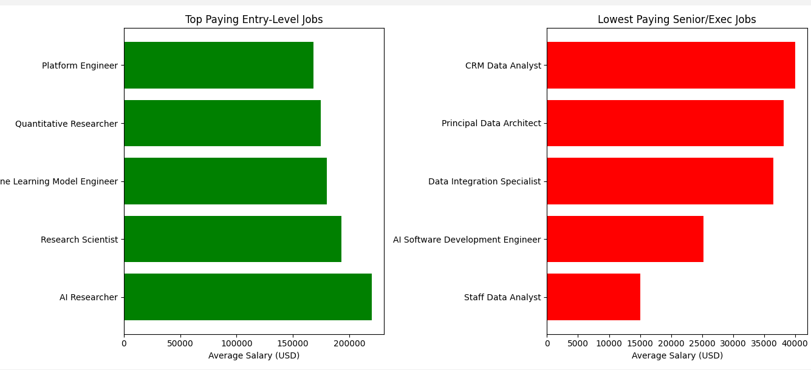
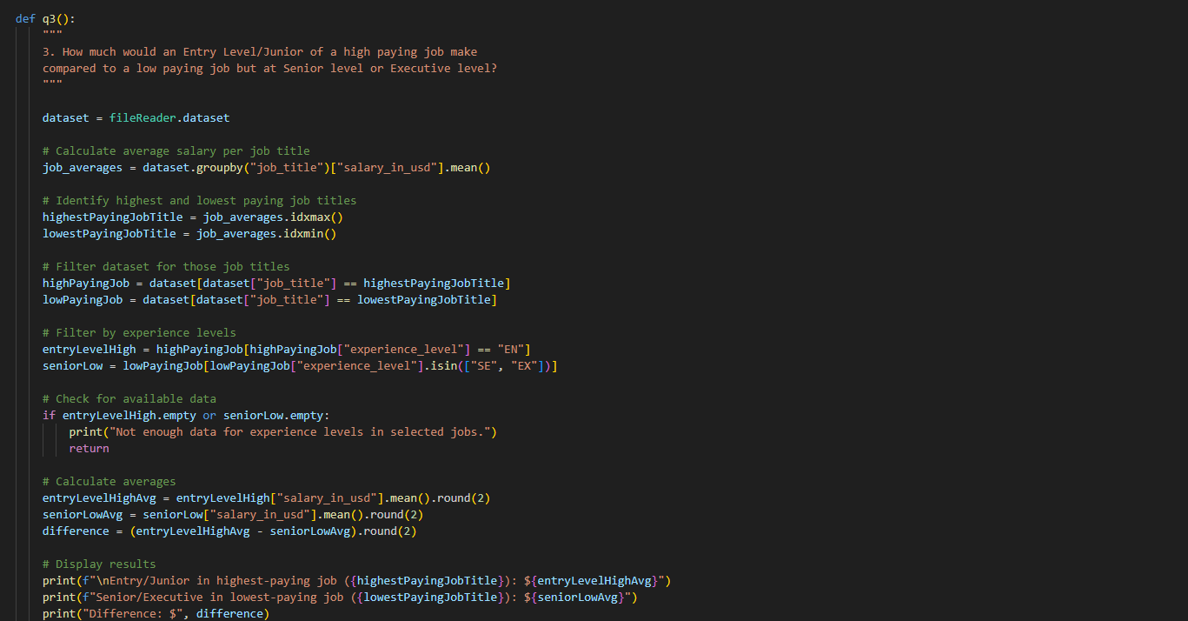
Questions (Prajesh)
visualisation
Q3 > How much would an Entry Level/Junior of a high paying job make compared to a low paying job but at senior level or Executive level?
The graph shows that the top paying entry level job is AI Researcher, and the lowest paying senior jobs is staff data analyst.

Slide 18
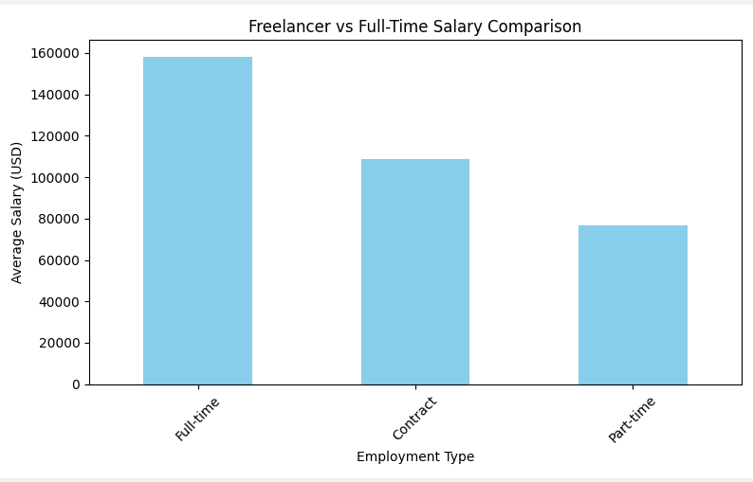
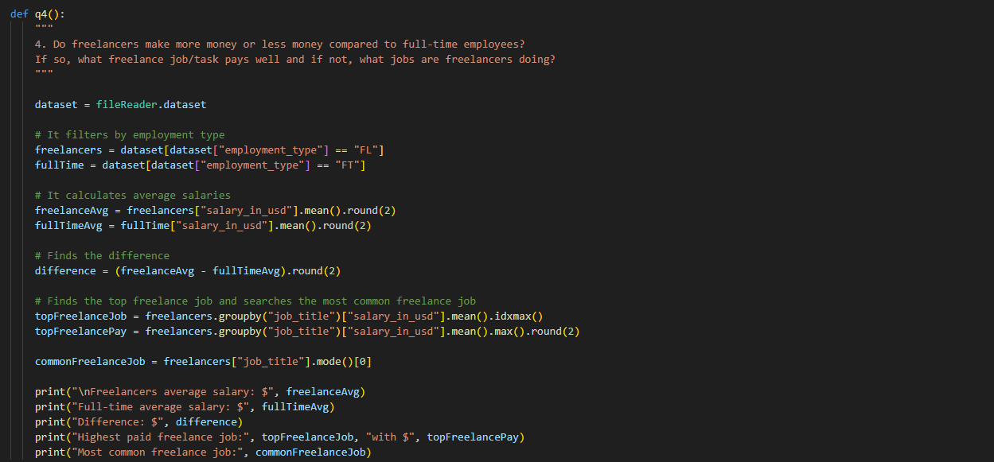
Questions (Prajesh)
Q4 > Do freelancers make more money or less money compared to employees who work fulltime and if so what job/ task allows a freelancer to get a good pay and if less what jobs are freelancers taking up?
Data shows that Full-Time employees make more money than people who freelance (contract) however freelancers make more money than people who do part time work
visualisation

Slide 19
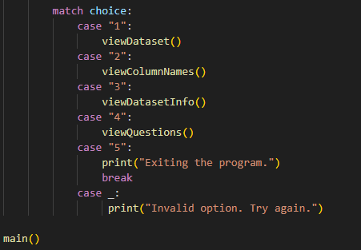
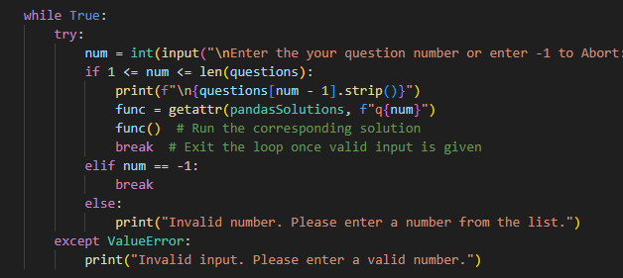
Testing
Uses case structure to provide error message for every input that isn’t one of the 5 menu options
While the questions use a try catch structure to provide different error messages for invalid numbers and letter responses.
These cover all the user inputs preventing the code to close abruptly at any point

Slide 20
Evaluation
Benefits: Introduced the usage of git and github to the members of a group and helped show how teamwork in the field
Challenges: merging conflicts creating potential losses in progress and long periods of checking files for incorrect changes, finding periods where the whole group can communicate progress on the project.

